Slide 1
CYBER PULSE · ACCESSIBILITY INTELLIGENCE
ACCESSICITY
Don’t just find a route. Find a route you can actually use.
Accessibility-first smart navigation by Cyber Pulse.

Slide 2
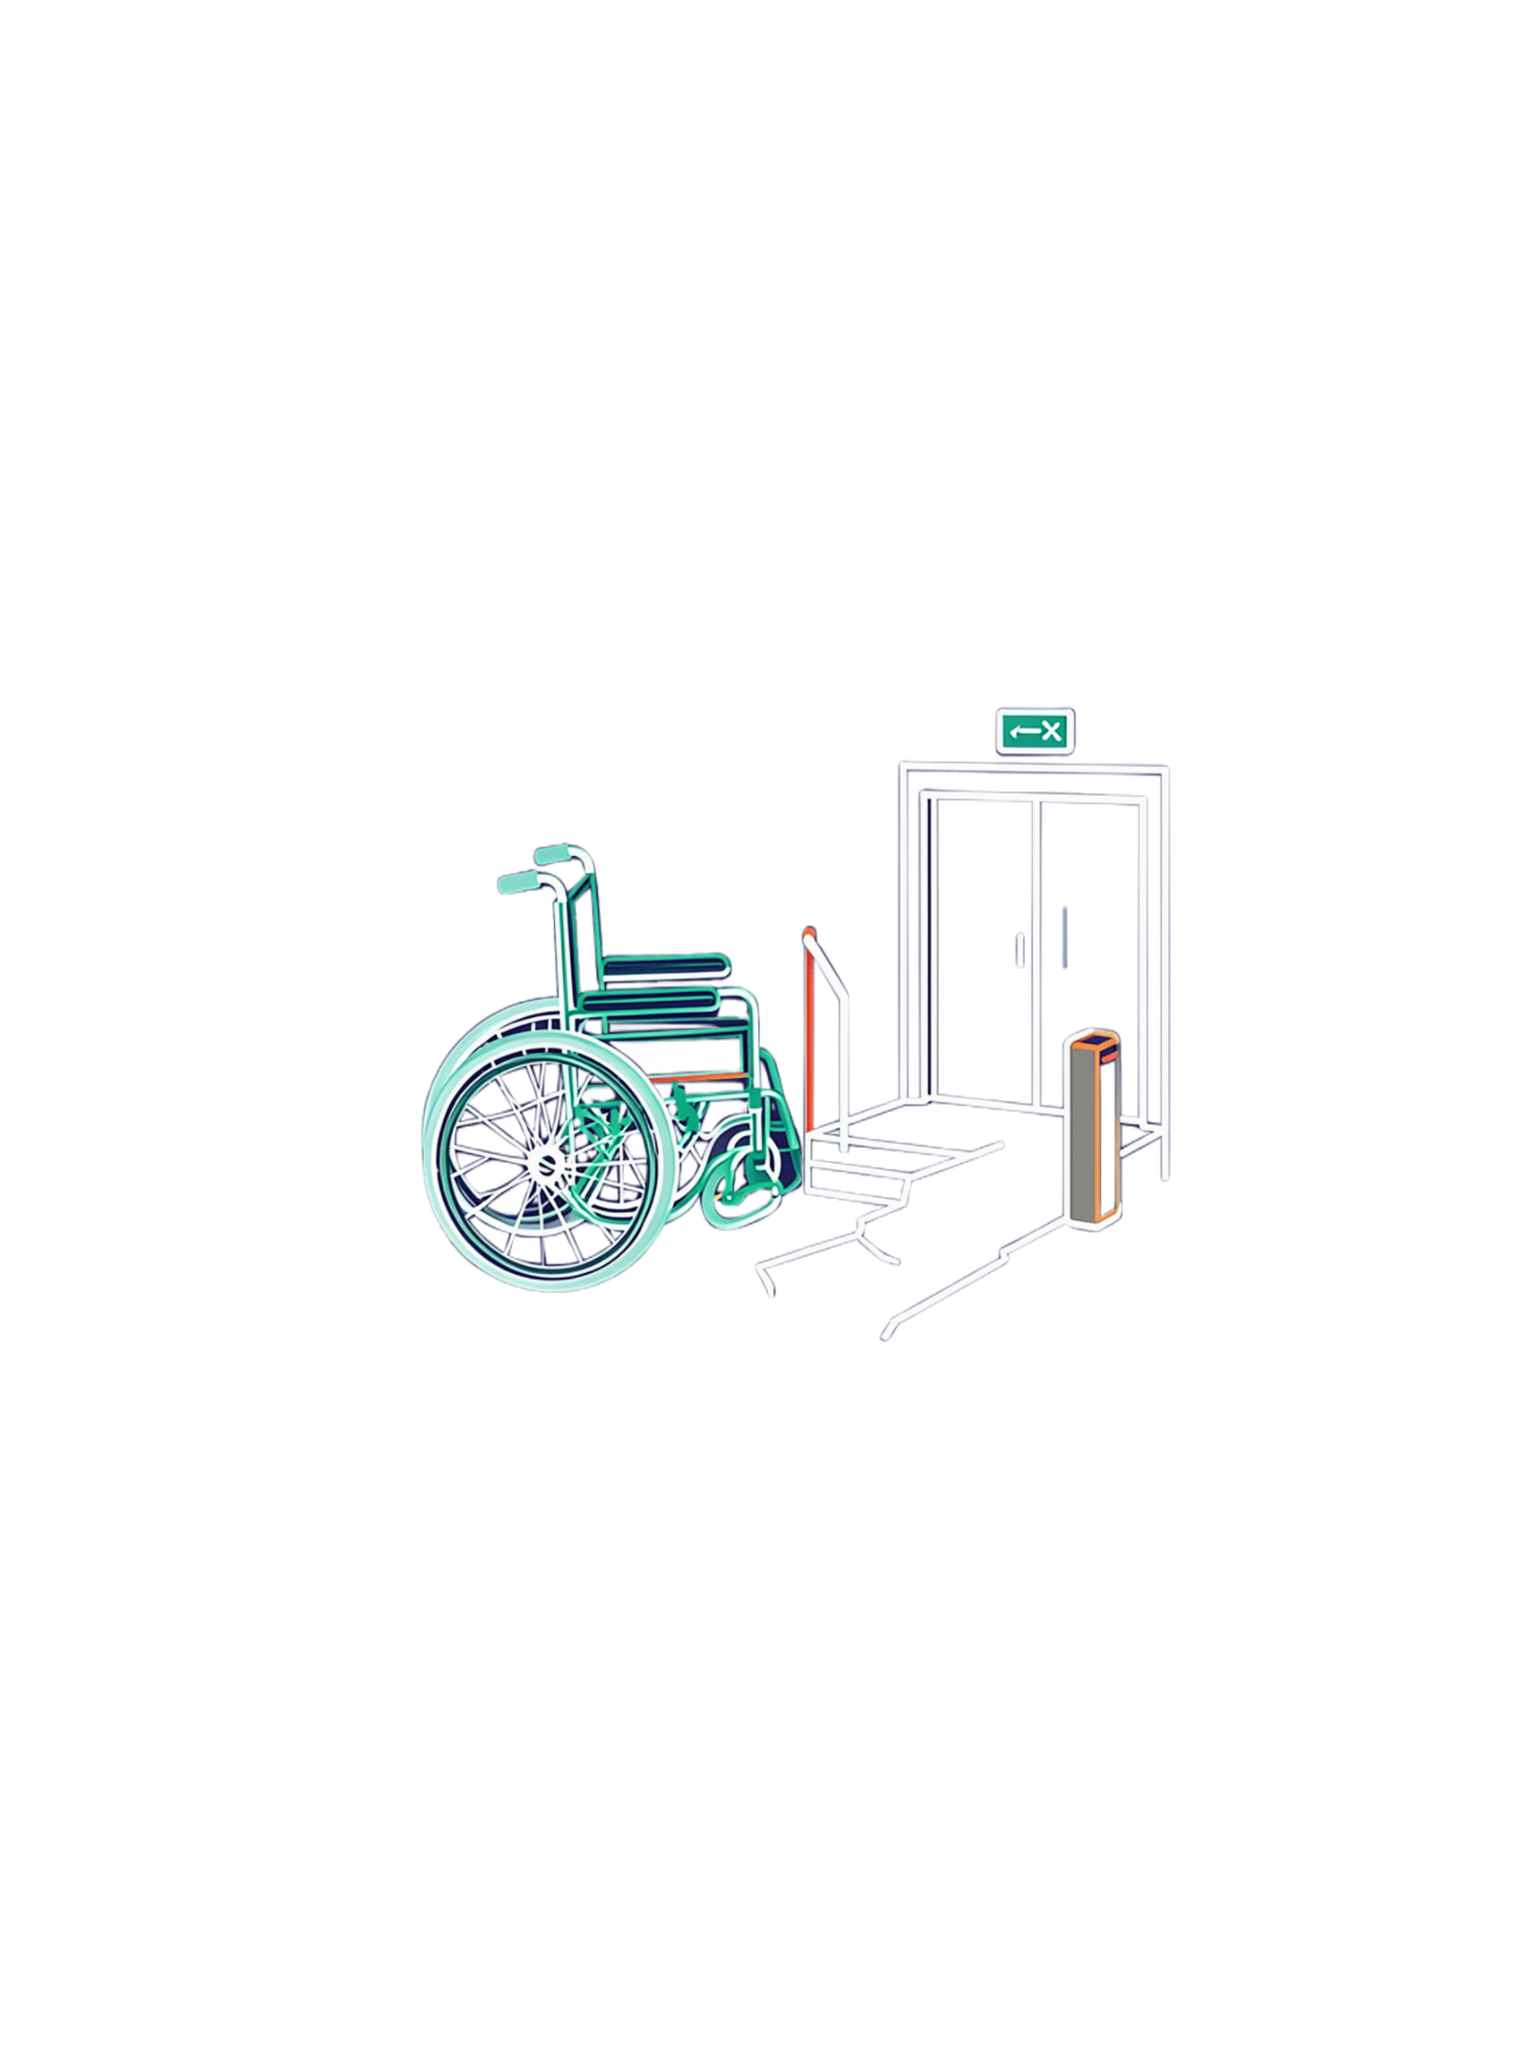
THE GAP
A route can be correct — yet unusable
Traditional navigation optimizes speed and distance, not continuity.
A short staircase, broken footpath, missing lift, or blocked entrance can invalidate the entire journey.
CORE QUESTION
Can the person physically complete the route?

Slide 3
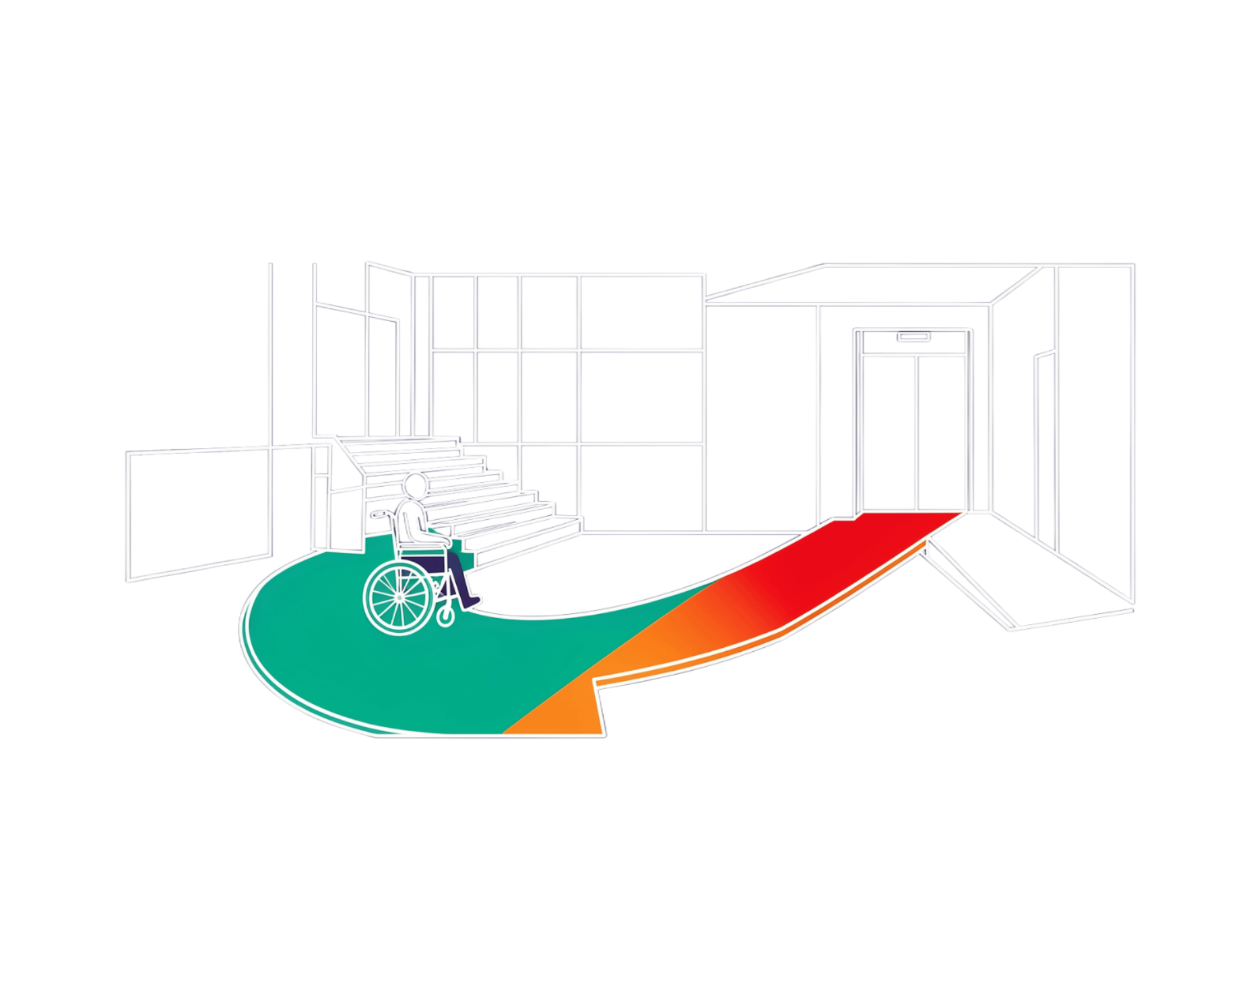
A ROUTE IN PRACTICE
The 500-metre route that still fails
One nearby building. Two possible journeys.
FASTEST ROUTE · 5 MIN
ACCESSIBLE ROUTE · 8 MIN
Stairs → impossible
Ramp + elevator → feasible
The shortest route is only useful when it remains feasible.

Slide 4
THE ROUTING SHIFT
Accessibility is a routing constraint
01 · TRADITIONAL MAPS
02 · ACCESSICITY
Feasible
Fastest
Step-free, barrier-aware, user-specific, evidence-scored.
Shortest, traffic-aware.
Feasibility comes before optimization.
Hard barriers remove graph edges. Uncertain conditions become visible warnings.

Slide 5
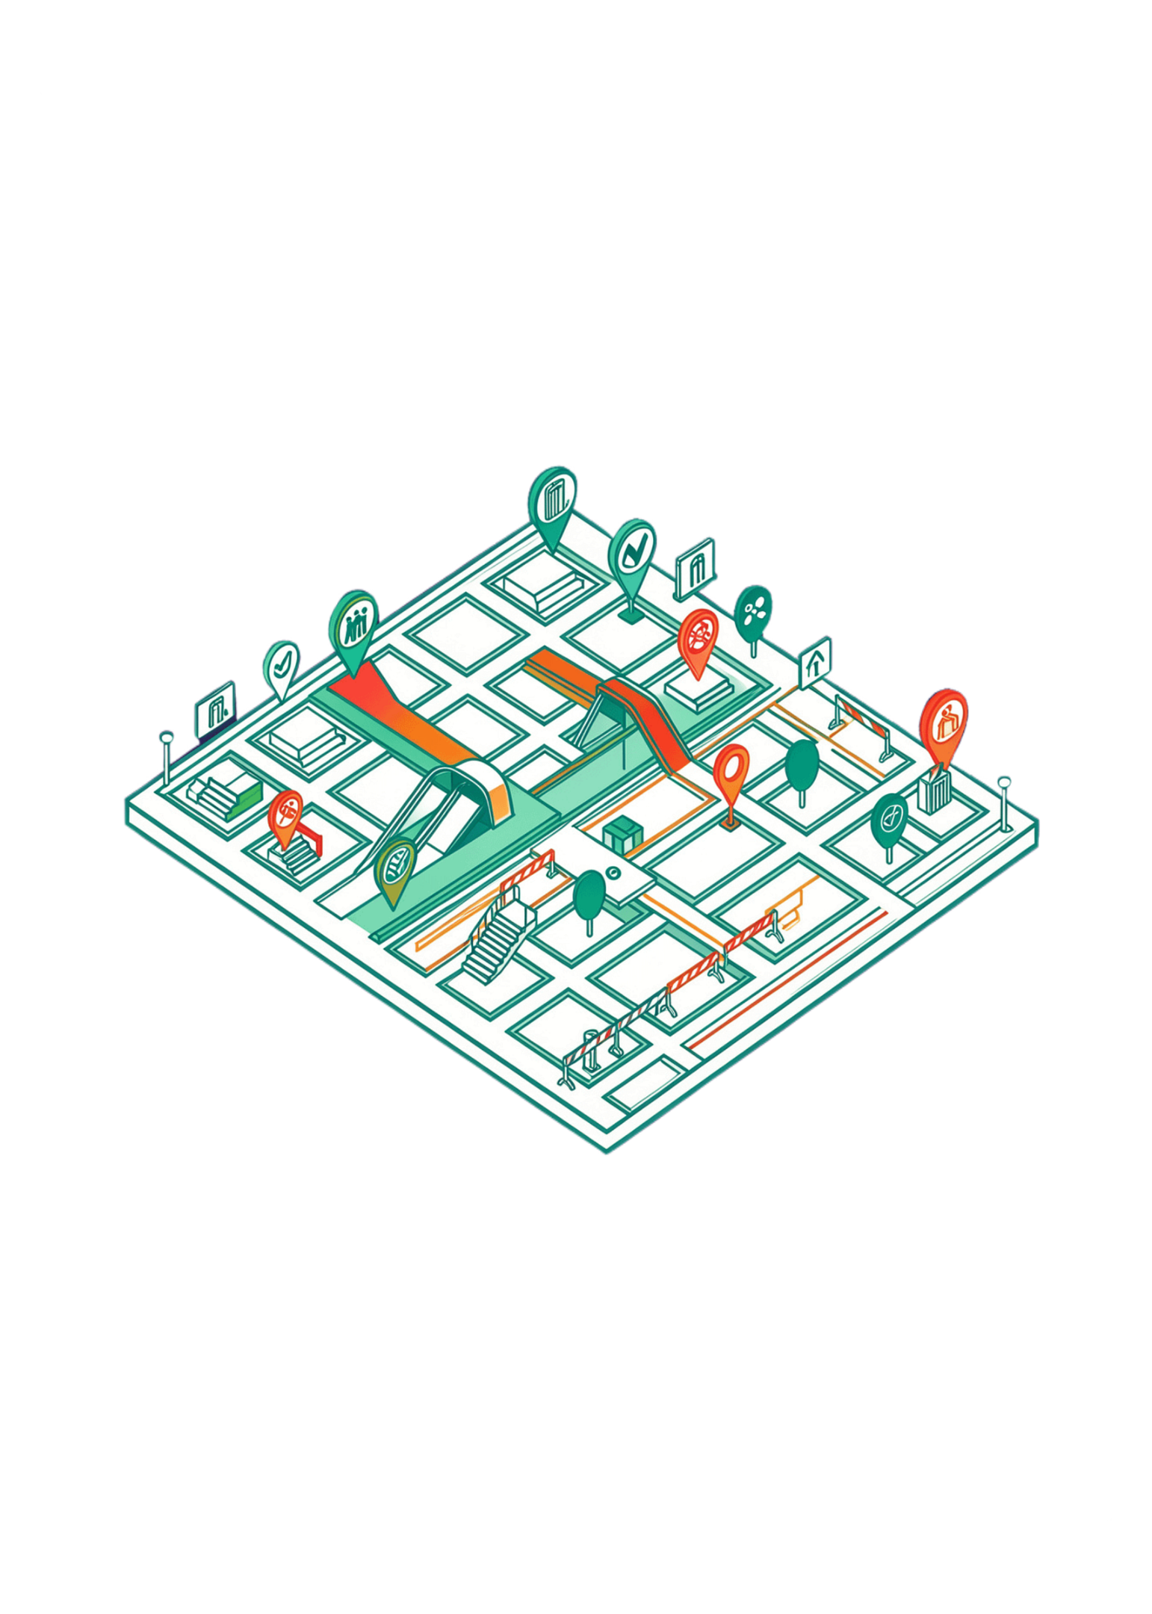
THE PRODUCT POSITION
AccessiCity is an intelligence layer, not a map clone
Enrich existing map infrastructure with:
Ramps
Verified entrances
Lift status
Stairs
Accessible paths
Temporary barriers
Photo evidence
Community reports
Every accessibility claim carries confidence and recency so the route can explain why it was chosen.

Slide 6
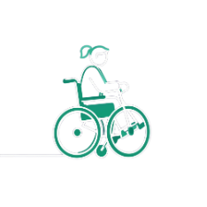

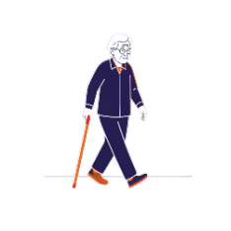
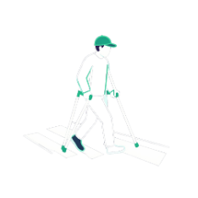


WHO IT SERVES
The users are diverse — the need is shared
Wheelchair users
Stroller parents
Older adults
People with temporary injuries or crutches
People carrying heavy luggage
Anyone who needs a step-free or lower-risk journey

Slide 7
THE USER FLOW
Choose → filter → verify → route
The user sees a usable recommendation, not raw map data.
01
02
Enter destination
Select accessibility needs
03
04
Check route evidence and live conditions
Generate the shortest feasible route

Slide 8
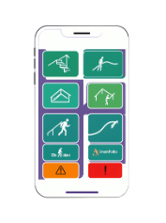
Avoid stairs
PERSONALIZATION
Personalized accessibility profiles
Require ramps
Require working elevators
Avoid steep slopes and difficult crossings
Preferences become routing constraints, not a cosmetic filter.
Prefer smooth footpaths
PROFILE ACTIVE
A profile turns lived experience into route logic.

Slide 9
ROUTE TRADE-OFFS
Shortest is not always best
AccessiCity optimizes for usability, not distance.
ROUTE | TIME | CONDITIONS | DECISION
Route A — Fastest | 5 min | 2 stairs | Not feasible
Route B — Shortest | 6 min | Broken footpath | Risky
Route C — Accessible | 9 min | Ramp + elevator | Recommended

Slide 10
EXPLAINABLE OUTPUT
One score makes trade-offs understandable
ACCESSIBILITY SCORE
92
The recommendation comes with evidence, not a black box.
Step-free continuity
Footpath quality and slope
/100
Hard barriers are removed. Low-confidence evidence creates warnings or penalties. Verified access is preferred.
Ramp and elevator availability
Crossing difficulty and obstacles
Confidence and recency

Slide 11
THE PRODUCT LAYER
AccessiCity adds intelligence to the map
An accessibility decision layer over OpenStreetMap — not a map clone.
WHEELCHAIR
FOOTWAY
STEPS
INCLINE
Access
Continuity
Barriers
Effort
entrance, lift, curb cuts
surface, width, obstruction
count, handrail, alternatives
slope, grade, fatigue risk

Slide 12
THE ACCESSIBILITY GRAPH
NODES
EDGES
Routes are feasible paths, not just short paths
Places
Segments
crossings · entrances · lifts · junctions
footways · ramps · stairs · road crossings
OSM features become a graph of nodes and edges. Each edge carries accessibility tags and a travel cost.
ROUTING
Dijkstra / A*
HARD CONSTRAINTS
Hard constraints + soft penalties for distance, incline, uncertainty, and effort.
Remove impossible segments first: stairs without an alternative, blocked footways, inaccessible entrances.

Slide 13
SYSTEM WORKFLOW
Choose → filter → verify → route
Five steps turn a destination request into a route a person can use.
01
02
03
04
05
Choose
Filter
Verify
Route
Explain
Set destination and profile.
Apply hard constraints.
Check evidence and confidence.
Run Dijkstra or A*.
Return GeoJSON and trade-offs.
Profile-aware: wheelchair user, low-vision traveler, limited stamina, or a route that avoids stairs — the same graph, different constraints.

Slide 14
REQUEST TO ROUTE
One clear flow from client to GeoJSON
01
02
03
04
05
Client
API
Spatial DB
Graph filter
GeoJSON
Profile + origin + destination
Validate request
PostGIS features
Constraints + penalties
Route + reasons
Frontend: profile controls, route map, accessible explanations. Backend: spatial queries, graph construction, routing, confidence-aware output.

Slide 15
TRUST OVER TIME
ASSISTING LAYER
Evidence is part of the route
Computer vision helps verify
Photos can suggest stairs, surface breaks, or blocked entrances. They support review; they are not the final authority.
Community reports become stronger when signals agree — and weaker when they age.
CONFIDENCE SIGNALS
Privacy-aware by design: minimize precise location retention and strip unnecessary photo metadata.
Community consensus
Contributor reputation
Timestamp freshness
Geofenced observations
Temporal confidence decay

Slide 16
BUILD THE MVP
TECHNICAL STACK
Start focused. Prove the loop.
Composable by design
Frontend
Backend
One campus or a small number of metro hubs — enough density to learn from real routes.
Map, profile, route narrative
API, graph, confidence
MVP BOUNDARY
Data
Algorithms
Accessible profiles and destination search
OSM + PostGIS accessibility features
Constraint-aware graph routing
Community evidence and explanations
OSM, PostGIS, GeoJSON
Dijkstra, A*, penalties

